Slide 1
Robust Deployable Antennas for CubeSats
The Communication Systems & Networks Research Group
Andrew Austin, Tim Pelham, Geoff Hilton,
and Mark Beach
2024 ESA Antennas Workshop
15 November 2024

Slide 2
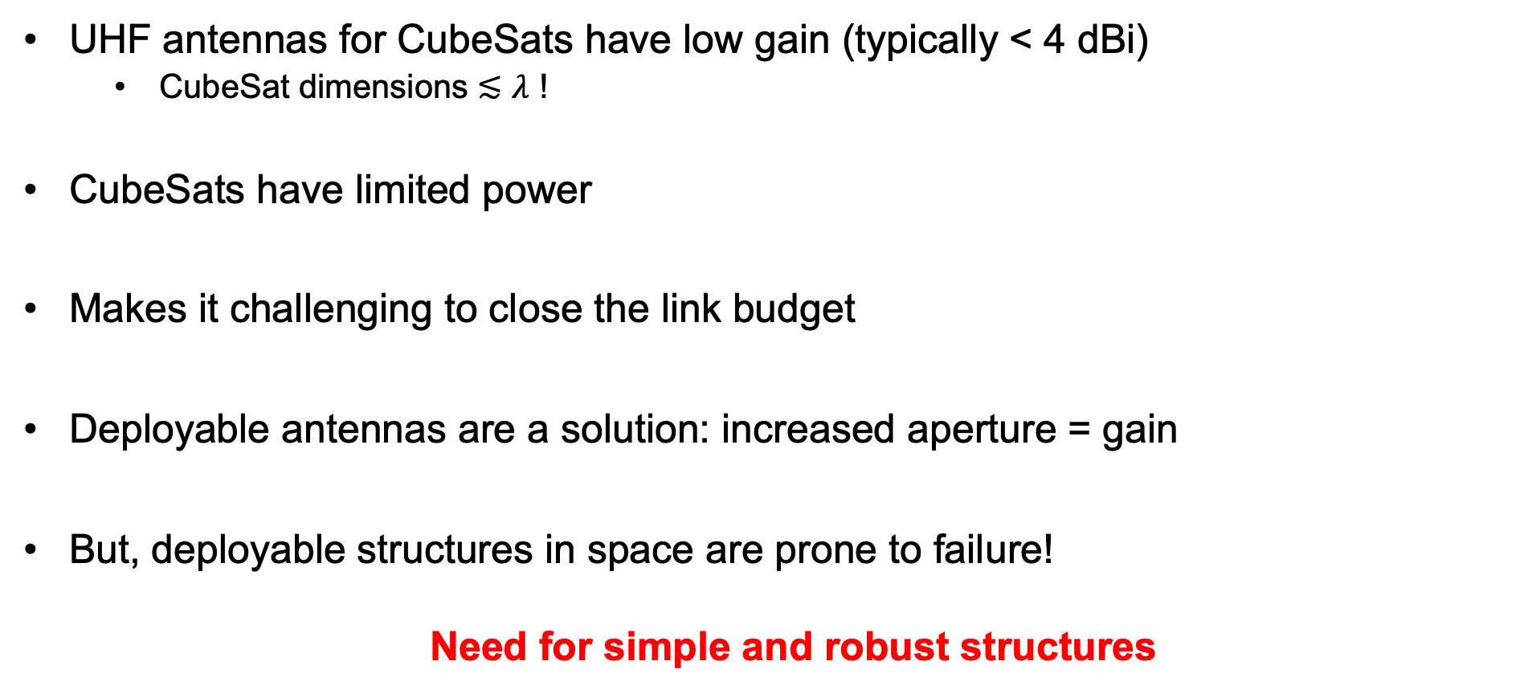
Motivations
UHF antennas for CubeSats have low gain (typically < 4 dBi)
CubeSat dimensions ≲ $λ$ !
CubeSats have limited power
Makes it challenging to close the link budget
Deployable antennas are a solution: increased aperture = gain
But, deployable structures in space are prone to failure!
Need for simple and robust structures

Slide 3
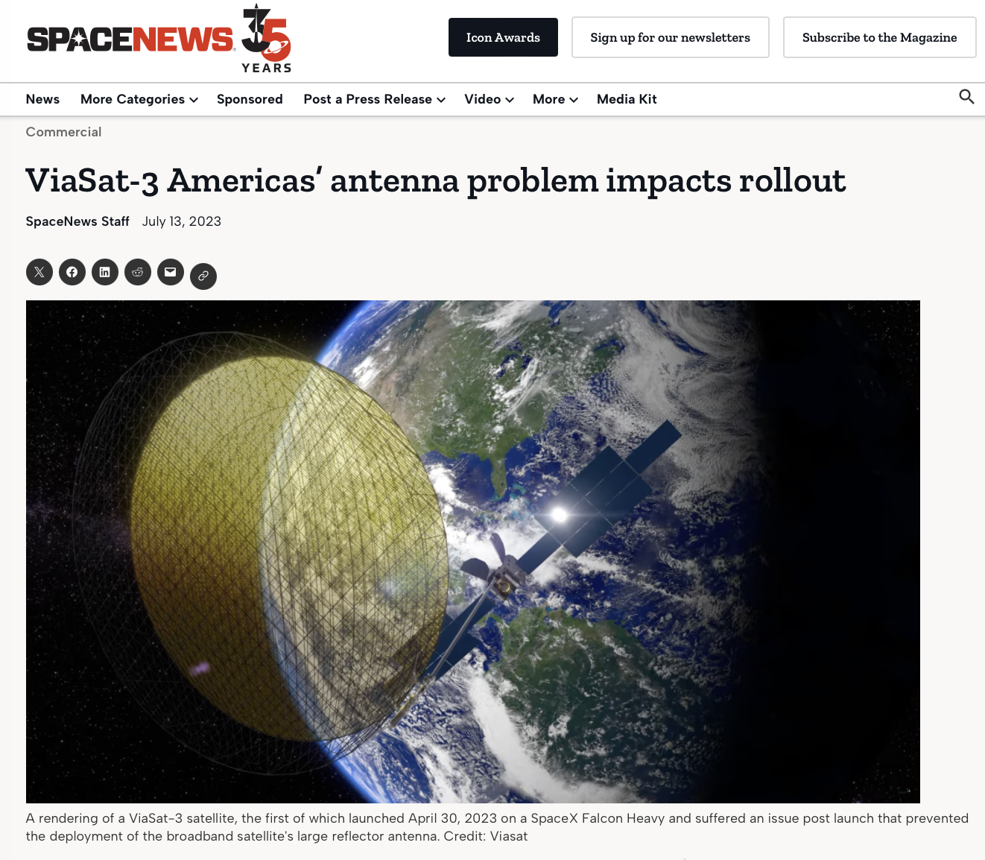
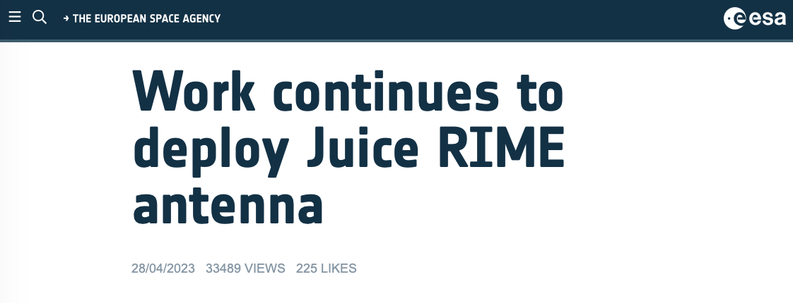
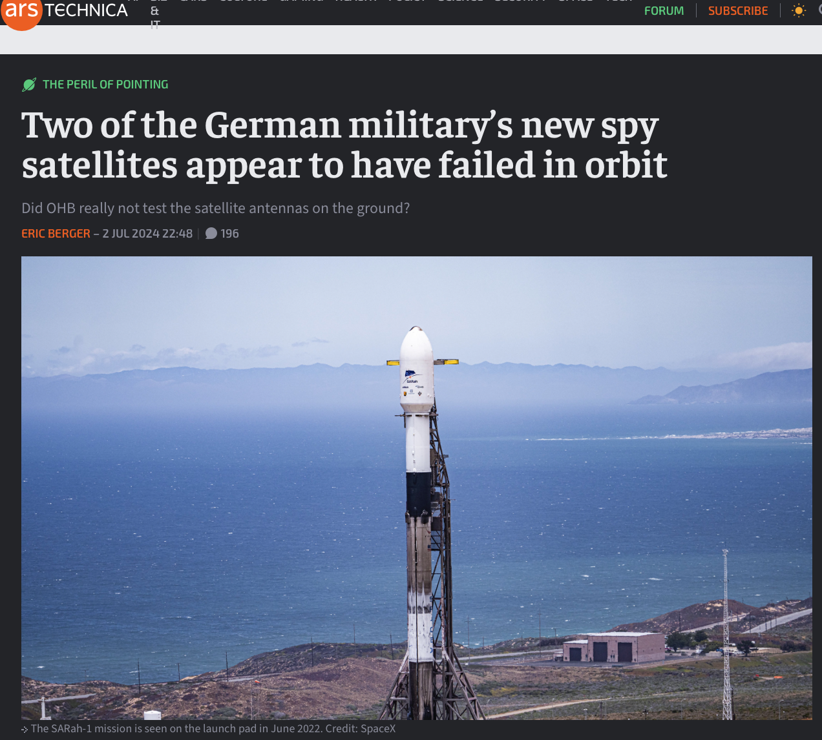
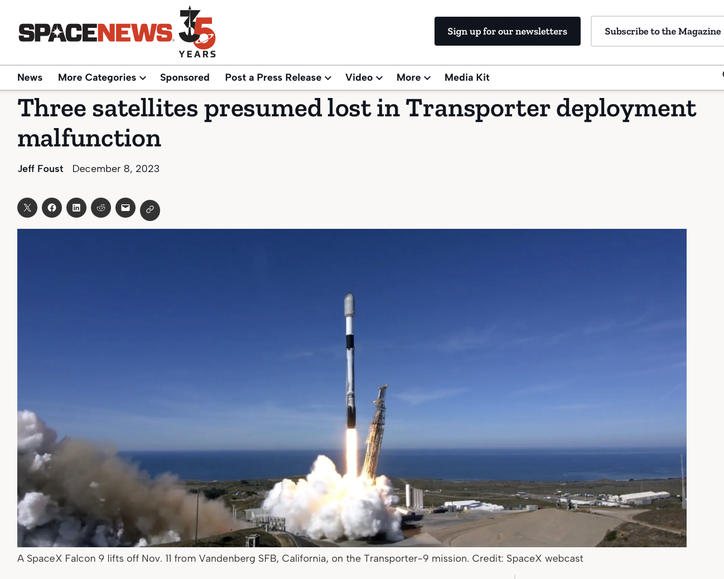

2023 insurance claims for failed satellite deployments was $900M

Slide 4
In this Presentation: Simple Reflectors!
Corner Reflectors
Deployment
Parametric study
Experimental measurements
Parabolic Cylindrical Reflectors
Deployment
Experimental measurements
Focus on antenna breadboards

Slide 5
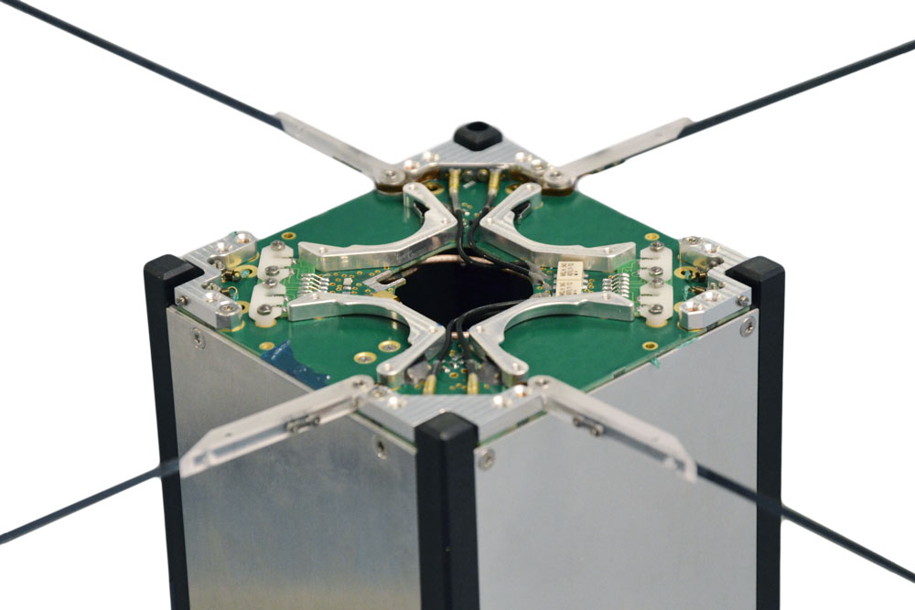
Existing Deployable CubeSat Antennas
Monopole / Dipoles
Long flight heritage: well tested design
Low gain!
Generally for low-data rate comms only…
Photos from ISISPACE

Slide 6
Deployable Corner Reflectors
8U CubeSat
Stowed
Deployed
Monopole assumed to be already been deployed
Metal corner reflectors folded out: increases effective aperture

Slide 7
Radiation Patterns: Measured
Null above monopole
Main lobe
Frequency = 1.5 GHz
+5 dB
Chassis acts as a ground plane
Reflectors Deployed
Reflectors Stowed
Measured Directivity = 3.7 dBi
Measured Directivity = 8.6 dBi

Slide 8
Cross-Polarisation
Reflectors Stowed
Reflectors Deployed
Cross-pol levels 15 dB lower than co-pol
Some increase when the reflectors are deployed: low enough not to be of concern

Slide 9
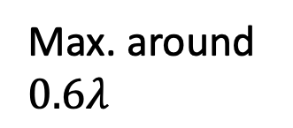
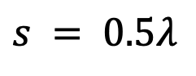
Parametric Sweeps
CST simulations varying size of reflectors and angle
Includes full chassis (modelled as PEC)
$s = 0.5λ$
Max. around $0.6λ$
Distance from the vertex

Slide 10
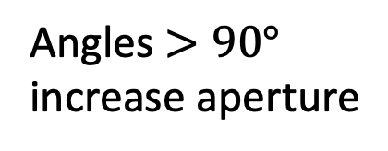
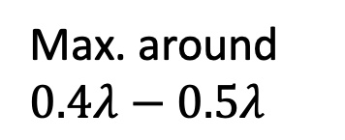
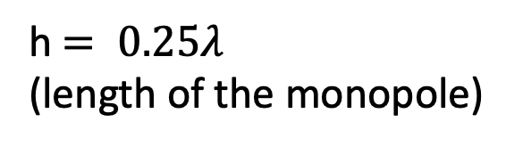
Parametric Sweeps
h$= 0.25λ$
(length of the monopole)
Angles $>90°$ increase aperture
Max. around $0.4λ−0.5λ$
Multiple lobes
While possible to further optimize: prototype achieves close to max. gain
Height of the reflector
Opening angle

Slide 11
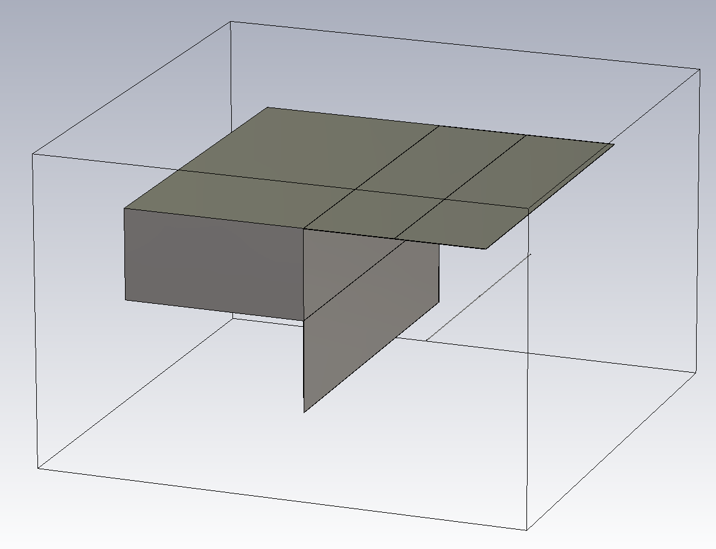
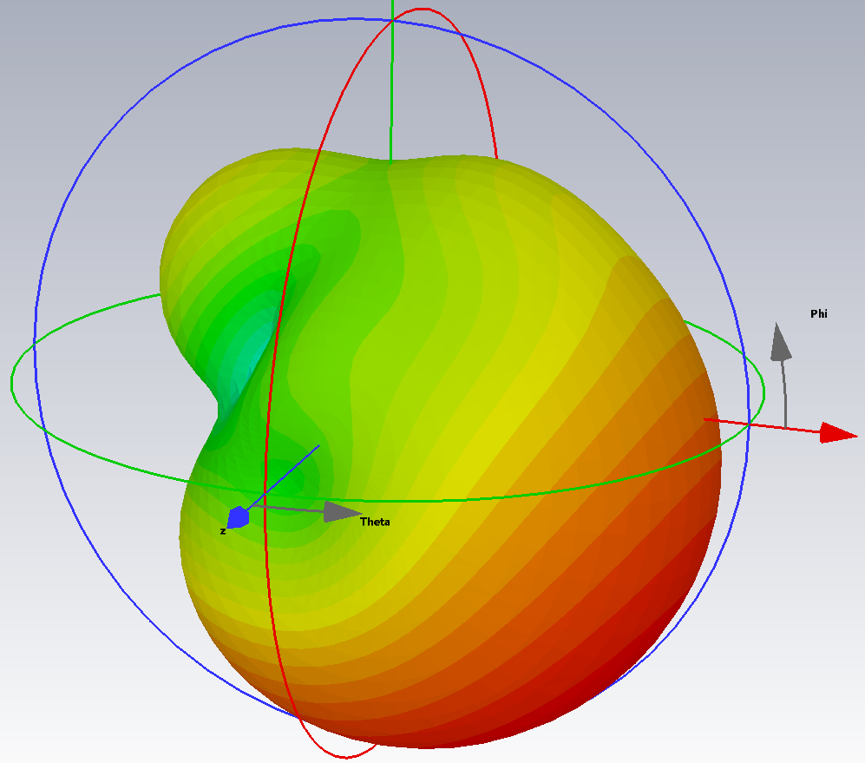
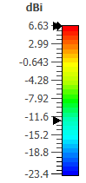
Alternative Deployments
Reflectors Deployed
Folding reflectors: could also be used for solar panels
8U CubeSat Chassis
433 MHz Dipole
Without reflectors, typical gain is ~2 dBi
Max. Gain 6.7 dBi

Slide 12
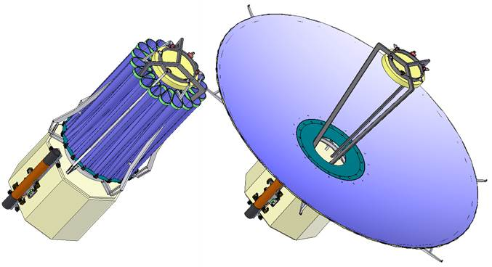
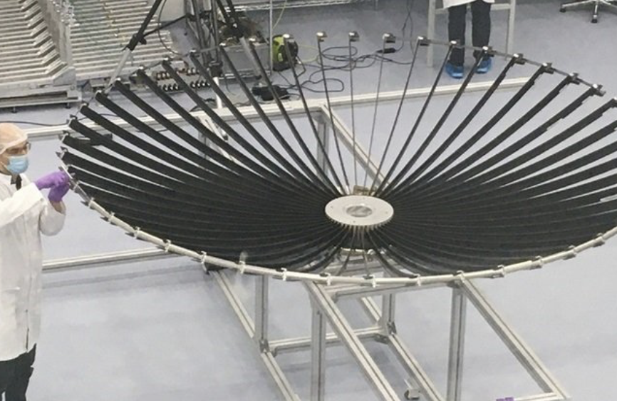
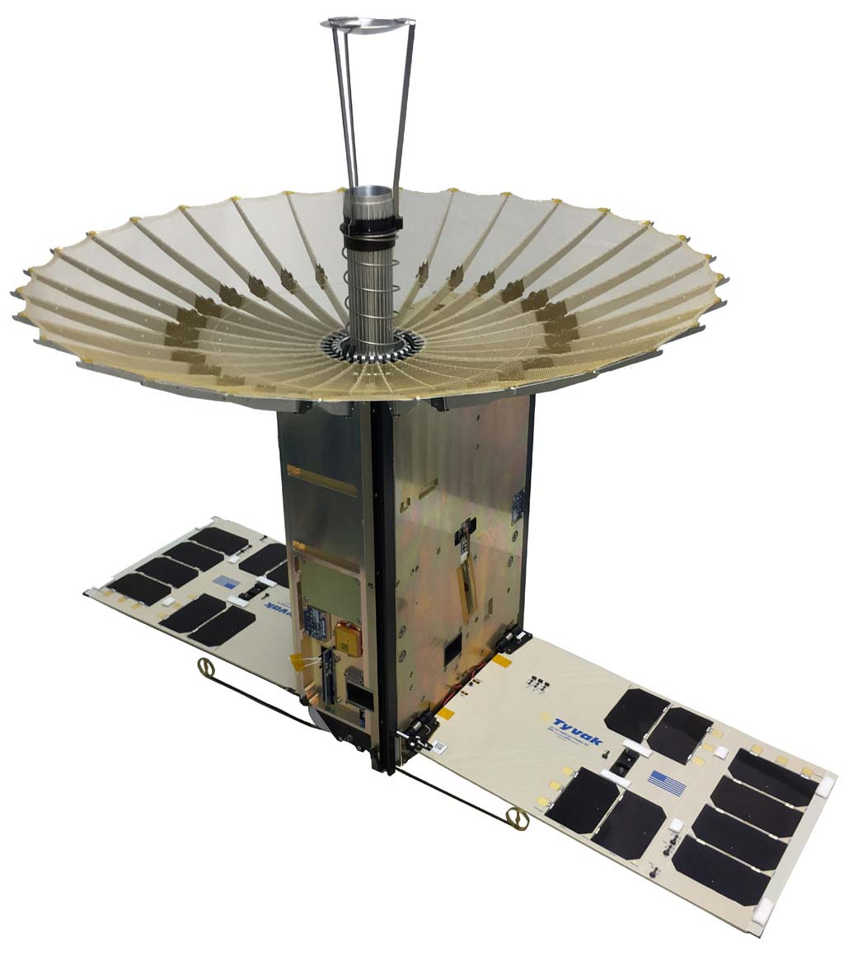
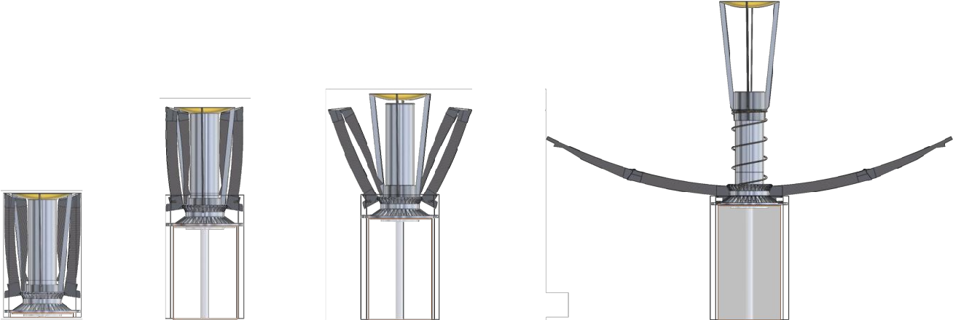
Existing Deployable Parabolic Reflectors
Oxford Space Systems deployable reflectors
NASA RainCube
Ka Band, 42 dBi gain
High gains possible
Complex deployment mechanisms (especially for CubeSats)
Interest in high gain antennas for CubeSat SAR

Slide 13
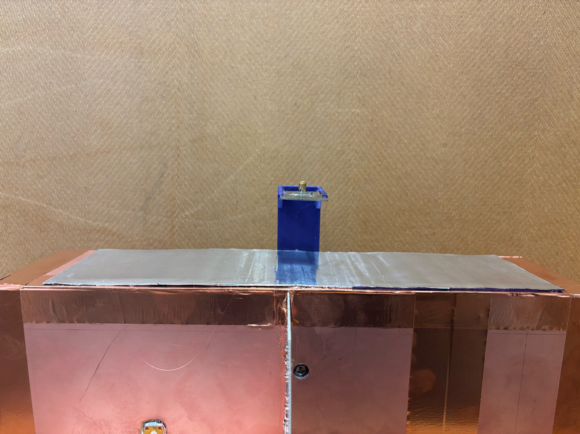
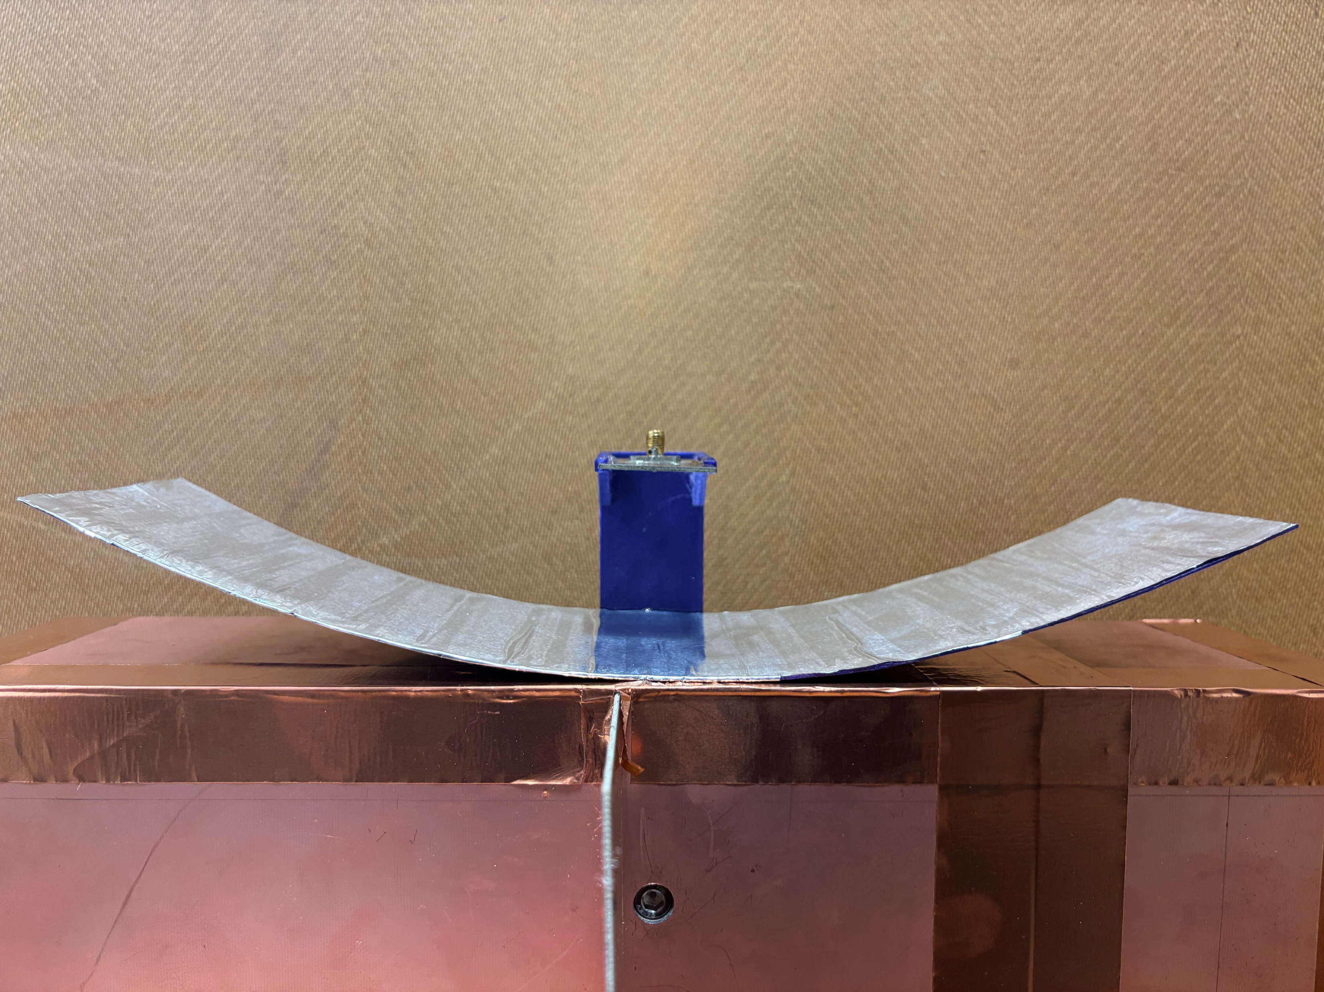
Parabolic Cylindrical Reflectors
Stowed state: held flat against the chassis
Needs material to be flexible and retain shape (no mechanical creep!)
Deployed state: parabolic reflector in one plane
Feed also needs to be deployed at correct F/D

Slide 14
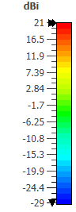
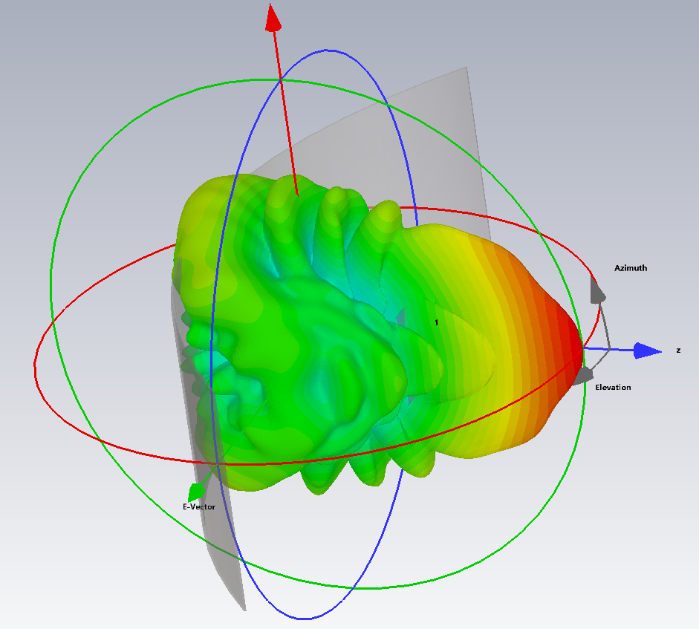
CST Simulations
Max gain = 21 dBi
10 GHz with F/D = 0.3
Potentially a good pattern for SAR!

Slide 15
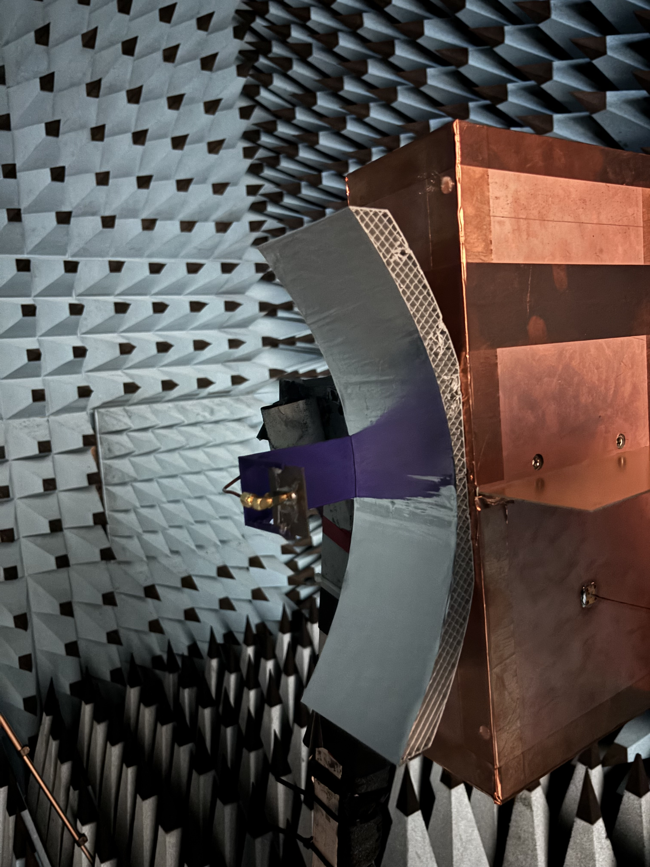
Prototypes and Measurements
Rigid shell: thin shell works, but prone to mechanical distortion
F/D = 0.3
Aluminum tape
Measured directivity at 10 GHz = 20.1 dBi

Slide 16

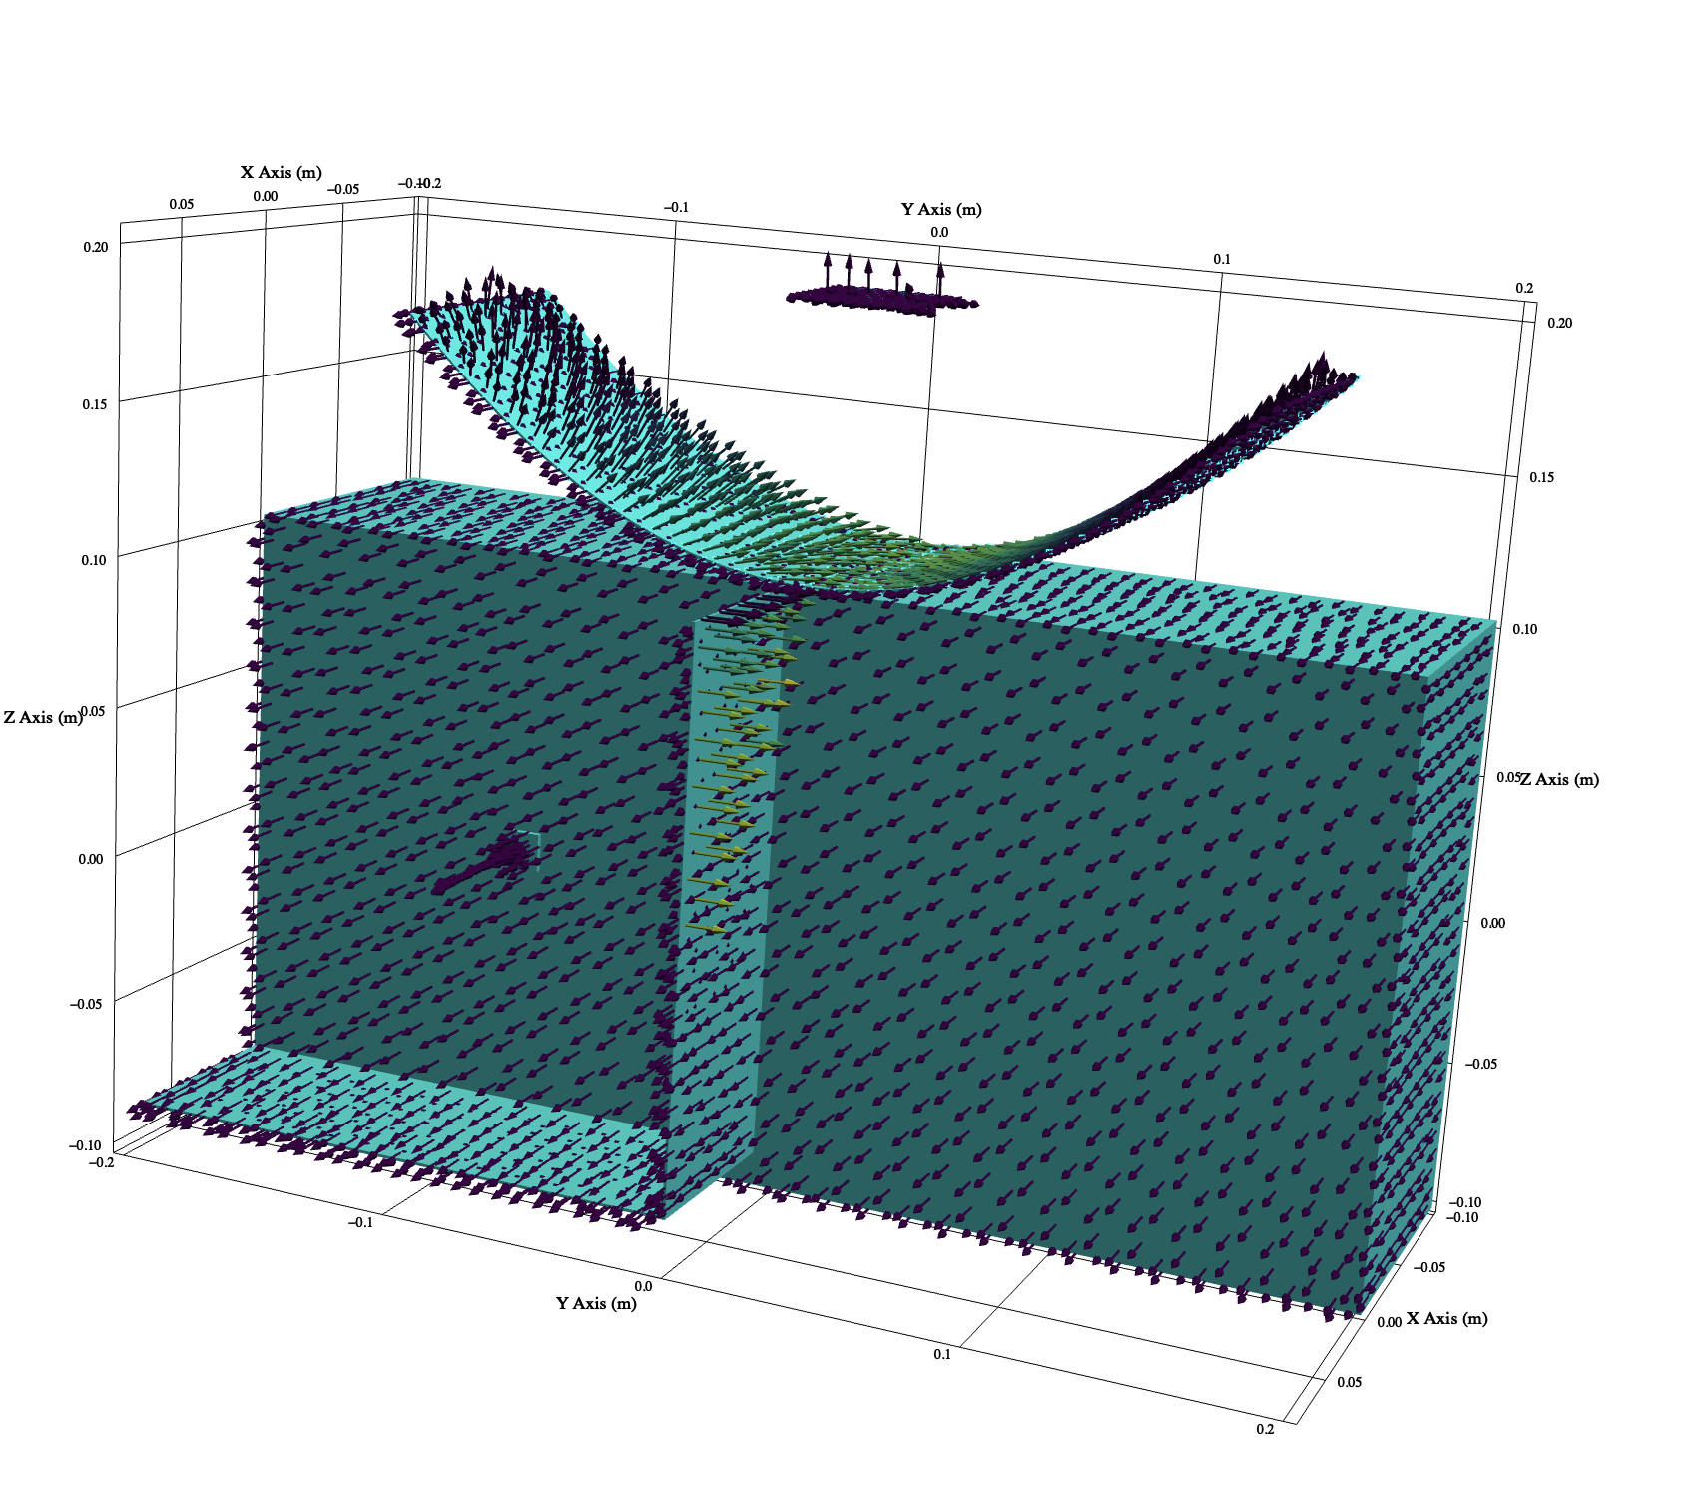
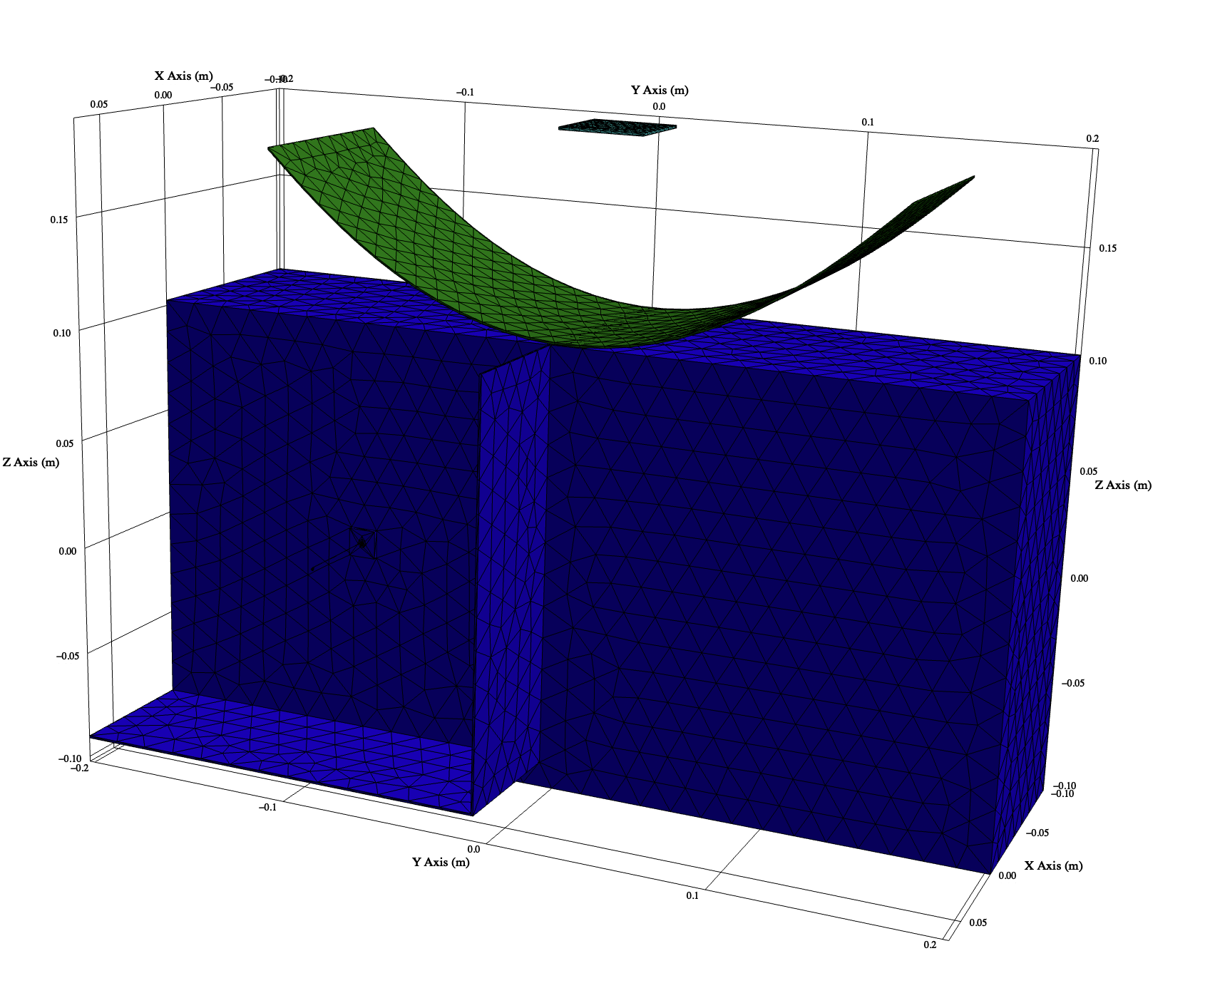
LyceanEM Comparison with Chassis
CST simulations did not include the chassis: some differences observed in the back lobe
https://lyceanem.com/lyceanem/

Slide 17
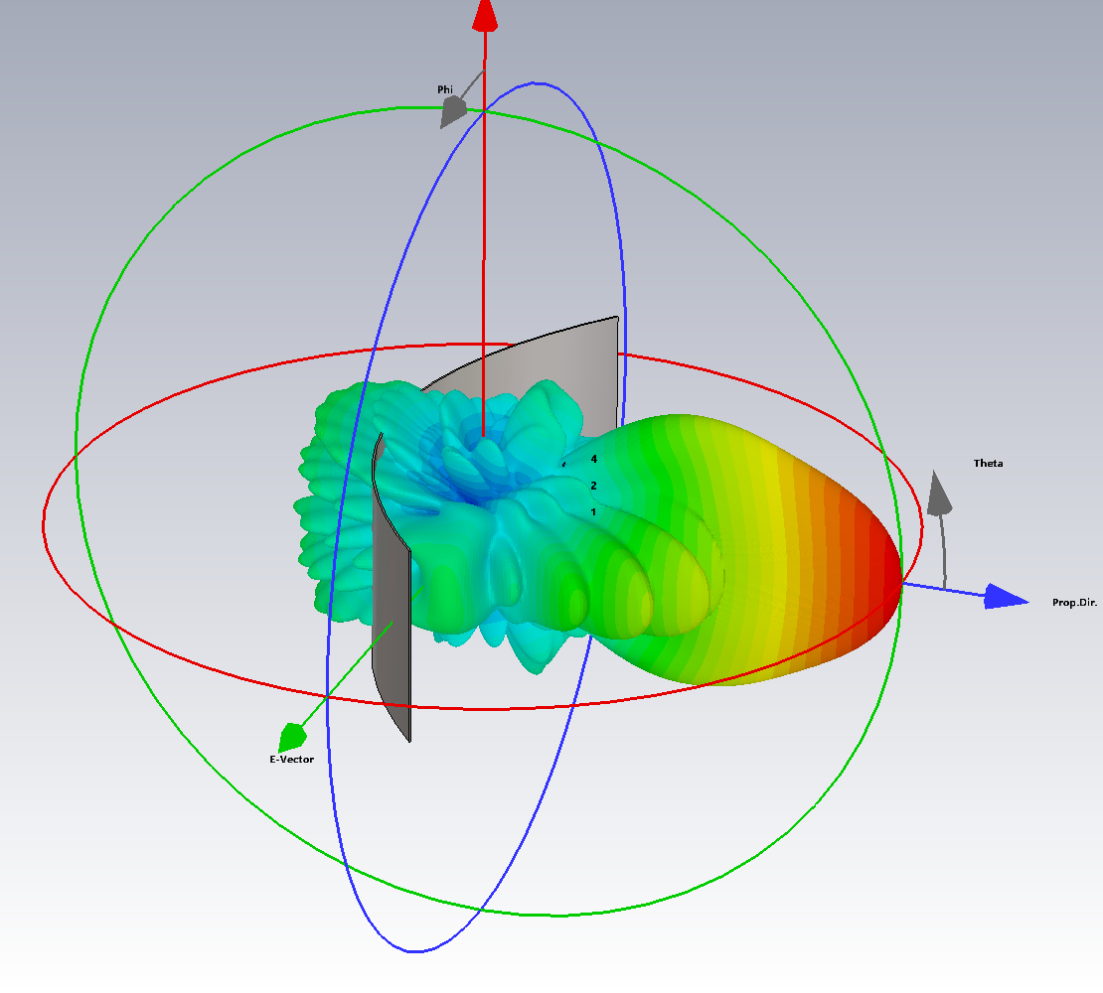
Further Improvements
Currently: single-element 10 GHz patch antenna used as feed: does not fully illuminate the reflector
Use a 5-element patch array:
Weighted elements to have -20 dB
side lobes
23 dBi gain
Max. gain from this effective aperture (10 GHz) is approx 26 dBi

Slide 18
Fabrication Considerations
Current prototype is polylactide (PLA) 3D printed thermoplastic…
Fine for an antenna engineering model
Not suitable for space: outgassing, subject to mechanical creep
Next prototype(s):
Glass or carbon fibre composite
Less prone to mechanical creep
Need to integrate in the reflective layer
Steel leaf spring

Slide 19
Summary and Conclusions
Need for robust and simple deployable antennas
Focus here on antenna engineering prototypes
Corner reflectors: 5 dBi gain improvement for a basic monopole
Parabolic cylinder reflector: 20 dBi gain possible at 10 GHz
Next steps: mechanical engineering prototypes

